Slide 1
Covid-19 Global Vaccination Analysis
Demonstrated by Biswarup Das

Slide 2
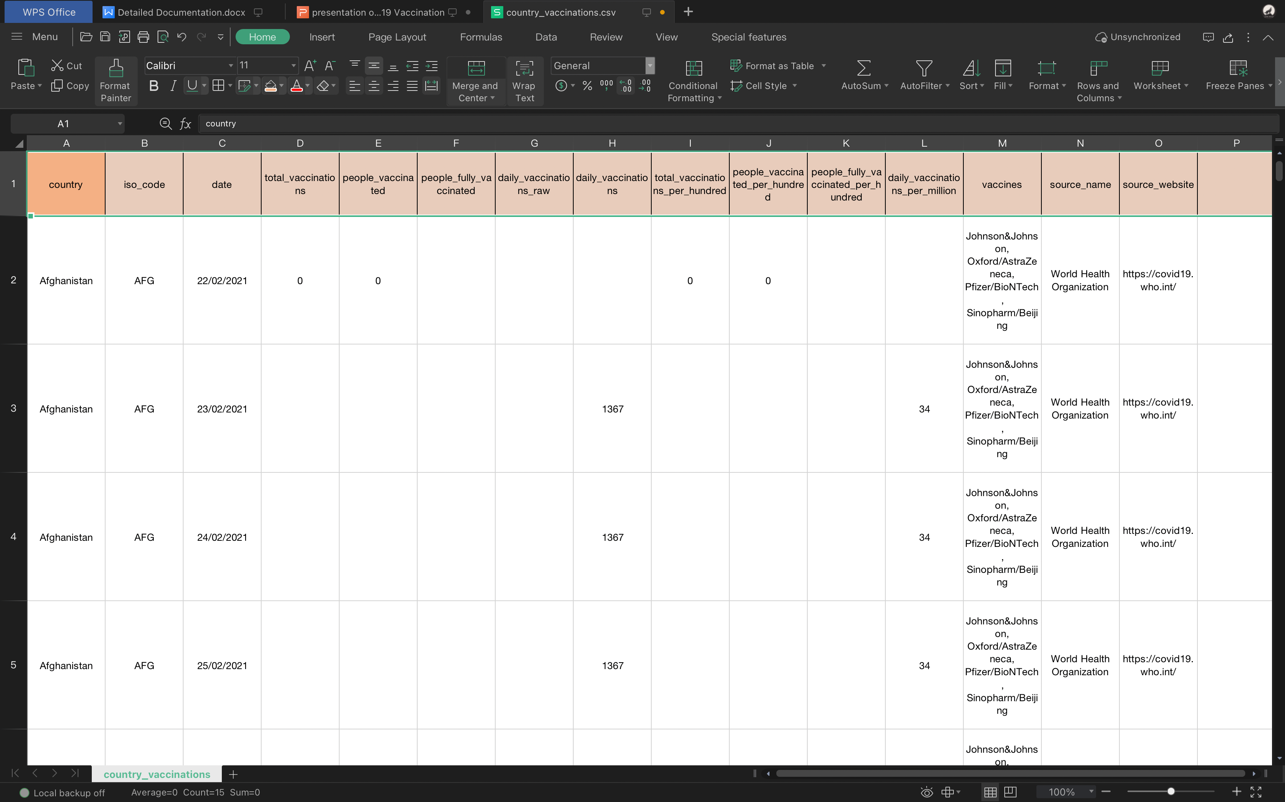
Understanding the Data Dataset link: https://drive.google.com/file/d/1w3Q2zie8Dkl1KB4aIl6FpGYfyYyKTc8c/view

Slide 3
Understanding the Data
The data (country vaccinations) contains the following information:
Country- this is the country for which the vaccination information is provided;
Country ISO Code - ISO code for the country;
Date - date for the data entry; for some of the dates we have only the daily vaccinations, for others, only the (cumulative) total;
Total number of vaccinations - this is the absolute number of total immunizations in the country;
Total number of people vaccinated - a person, depending on the immunization scheme, will receive one or more (typically 2) vaccines; at a certain moment, the number of vaccination might be larger than the number of people.

Slide 4
Understanding the Data
Total number of people fully vaccinated per hundred - ratio (in percent) between population fully immunized and total population up to the date in the country;
Number of vaccinations per day - number of daily vaccination for that day and country;
Daily vaccinations per million - ratio (in ppm) between vaccination number and total population for the current date in the country;
Vaccines used in the country - total number of vaccines used in the country (up to date);
Source name - source of the information (national authority, international organization, local organization etc.);
Source website - website of the source of information.

Slide 5
Problem statement
Finding top countires efficently performing vaccination drives and which organizations are actively participating.

Slide 6
Methodology
Using Power Bi to fetch the covid-19 vaccination dataset and prepare the dashboard as per the need. Use of pie chat, graph chart, cards, area chat, maps, etc to plot the data in the dashboard. Also remove unnessesary features from the dataset and clean it as much as possible.

Slide 7
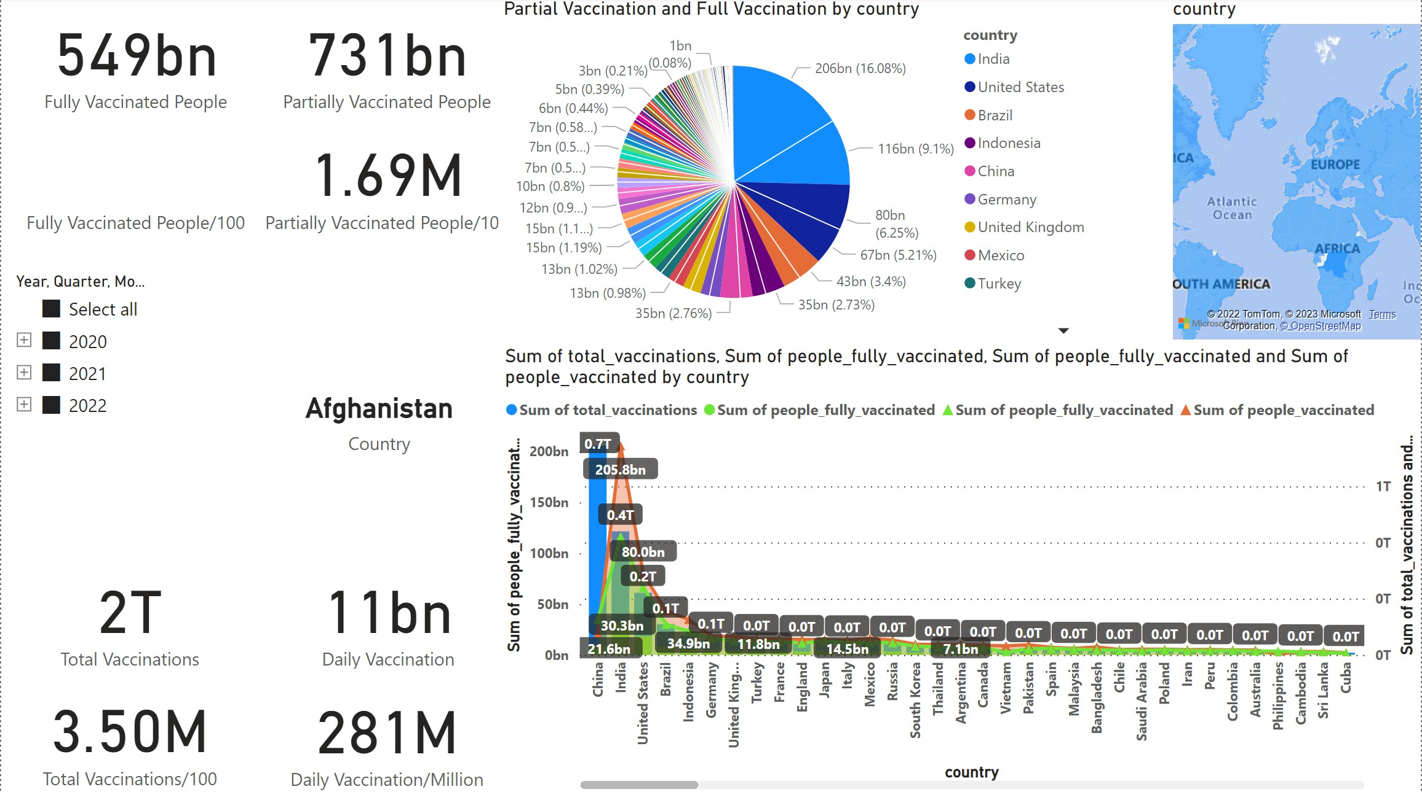
Overall Idea of Global Covid-19 Vaccination

Slide 8
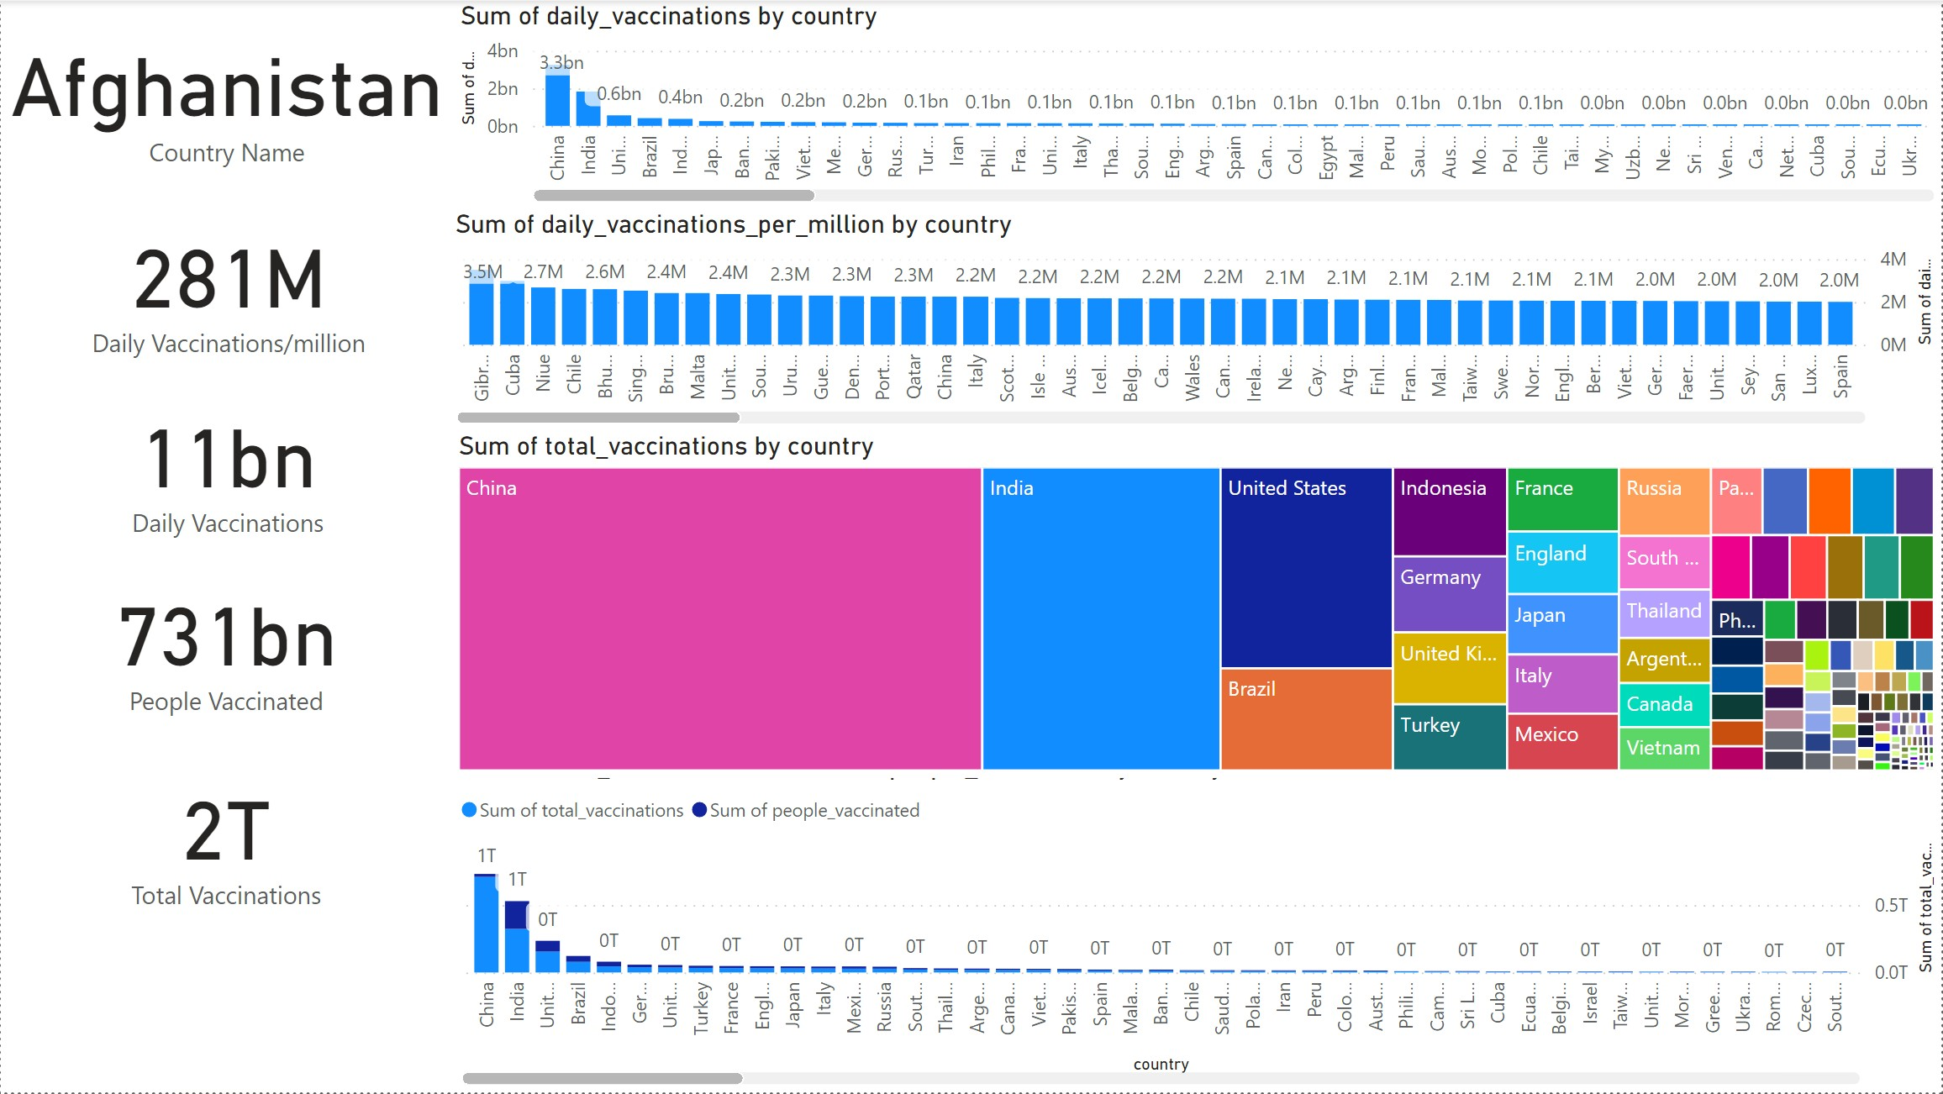
Vaccination Trend

Slide 9
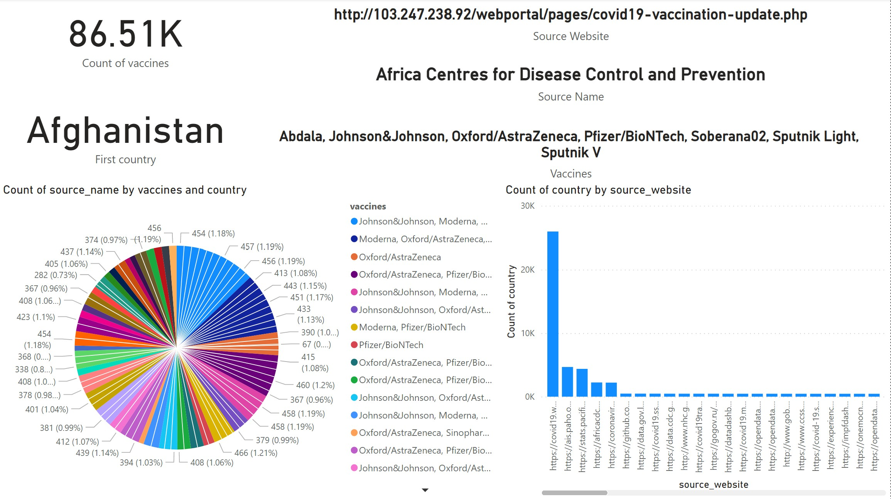
Vaccine Source & Authority

Slide 10
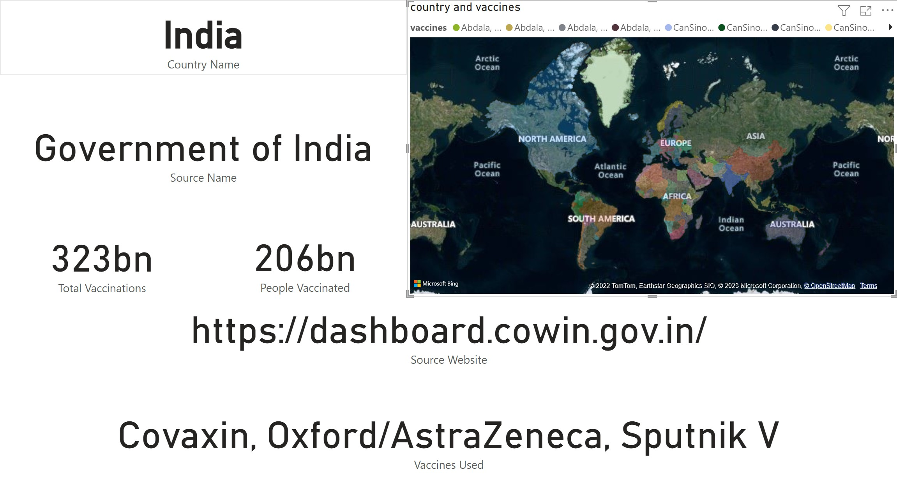
Country wise Vaccine Summary

Slide 11
Data Analysis
I have divided my analysis in 3 parts.
1: Overall idea
2: Vaccination Trend
3: Source & Authority
From my analysis I found:
Fully Vaccinated People : 549 billion
Partially Vaccinated People : 731 billion
Total Vaccinations : 2 trillion
Daily Vaccinations : 11 billion
Daily Vaccination/100 : 3.5 million
Daily vaccination/million : 281 million

Slide 12
Insights
If we merge full and partial vaccination then people of India has the higest percentage to vaccination (full:206bn,16.08%, partial:116bn, 9.1%).
In daily vaccination China is in the top position with 3.3 billion vaccination per day.
Gibraltar with 3.5 million vaccination per million hits the top in per million vaccination count.
In the count of total vaccination, again China comes on the top with 709 billion total vaccination.
Maximum vaccines are organised by the website https//covid19.who.int/
Abdala, Johnson&johnson, Oxford/AstraZeneca, Pfizer/BioNTech, Soberana02, Sputnik Light, Sputnik V are the most used vaccine. Vaccine count is 25.95K.

Slide 13
Recomendations:
All europian countries, China, India and some western countries are performing well in vaccination. So every NGO and other foriegn government should focus on central asian countires and some other african countries.
Also have to adopt some policies that implimented by developed countries and developing countries and have to use vaccination stragegies to the other countries.
International community should make a separate fund for countries with lower GDP to facilitate better health system and to run vaccination problem more smoothly.
WHO should place some watch dogs to monitor ground reality.

Slide 14
Conclusions
Coronavirus pandemic shows us how devastative it can be if we don’t take such things seriously. We have already experienced that how big economies were falling, we have also seen many job cuts and more importantly human life were at stake. Whole world stopped by lockdown. We should take it as a big lesson and make some changes in our global community and also country wise to deal with any eventuality related to health. We have to keep in mind that deaseases is not restricted to any country and it can spread all over the world in a speed that is beyond of our imagination. So we have to work as a one team one world to save the humanity. To do that every well known medical research foundation have to come forward and start woking together for a better future. We have allote funds for low gdp countries to imporve their health facilities. Together we can surive and can give our future generation a better life.

